Slide 1
Volunteer Management System for Texas Master Naturalists
February 2022

Slide 2
What is the VMS
VMS is an acronym for Volunteer Management System (the publisher is Samaritan)
It is web based software consisting of an administrator (eCoordinator) component and a volunteer (eRecruiter)component
There are no known restrictions on the browser used for either the administrator or the volunteer

Slide 3
Definitions
Opportunities: Service Projects or AT events.
Common Opportunities: those opportunities used by nearly all chapters; created for you
Survey: Form the volunteers use to enter hours
Log book: the record of volunteer hours
TMN Hours: service hours applied to a TMN event
AT Hours: advanced training hours (TMN)
Hours: hours earned at any other TPWD event
VMS Web Portal: txmn.org/hours/

Slide 4
Common Opportunities
AT: Chapter Meeting – advanced training
Chapter Meeting non-AT – service hours
Administrative Work – chapter management duties
Presentations – TMN volunteer presenters
AT: VMS Training – any classes/presentations of the VMS
Initial Training – TMN’s 40+ hour training
Historical Data (AT or Service Hours)

Slide 5
The Process - Generally
Approver: An Opportunity is created and a Survey is attached
Approver: Members are ‘approved’ for the opportunity
Volunteer: Members report their service/AT online
Hours Keeper: The Administrator approves the hours

Slide 6
TPWD Volunteer Registation
All Master Naturalists need to be registered with TPWD as a volunteer and issued a VMS user ID
Registration web site: txmn.org/apply
Search for “Apply to “; select your Chapter name
You must agree to a background check and agree to a Workforce Waiver to be registered
If you already volunteer with another TPWD program (Angler Education, State Parks, etc), you are already registered and can use the same user ID to log on and report TMN hours

Slide 7
Your Volunteer User ID
When you registered, you selected a user ID
The password is case sensitive
You should change your password periodically
Passwords must be at least 8 characters long and include at least one numeral
You may change your password by “editing your profile” from the volunteer dashboard

Slide 8
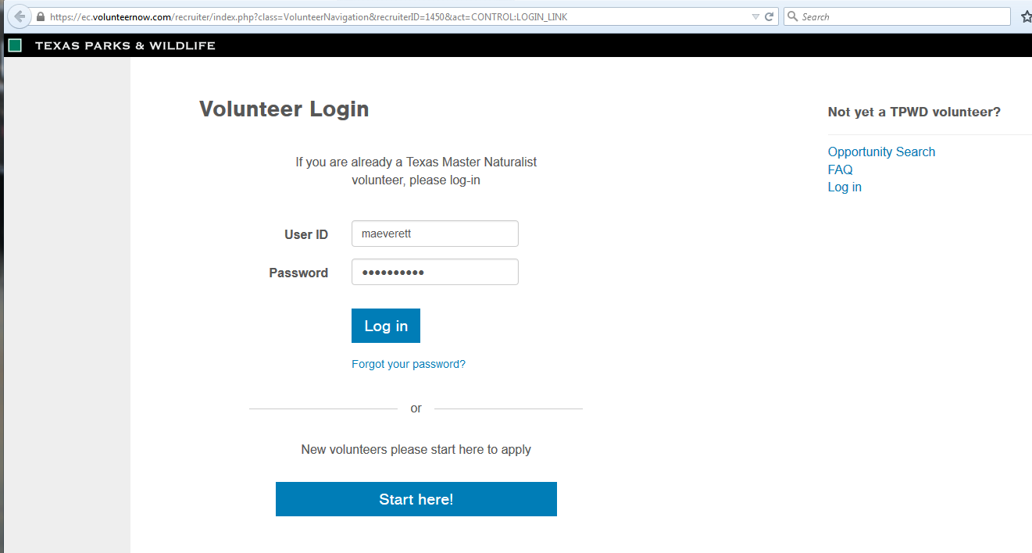
Volunteer Login Page
You must click “Login in” after entering the User ID and password

Slide 9
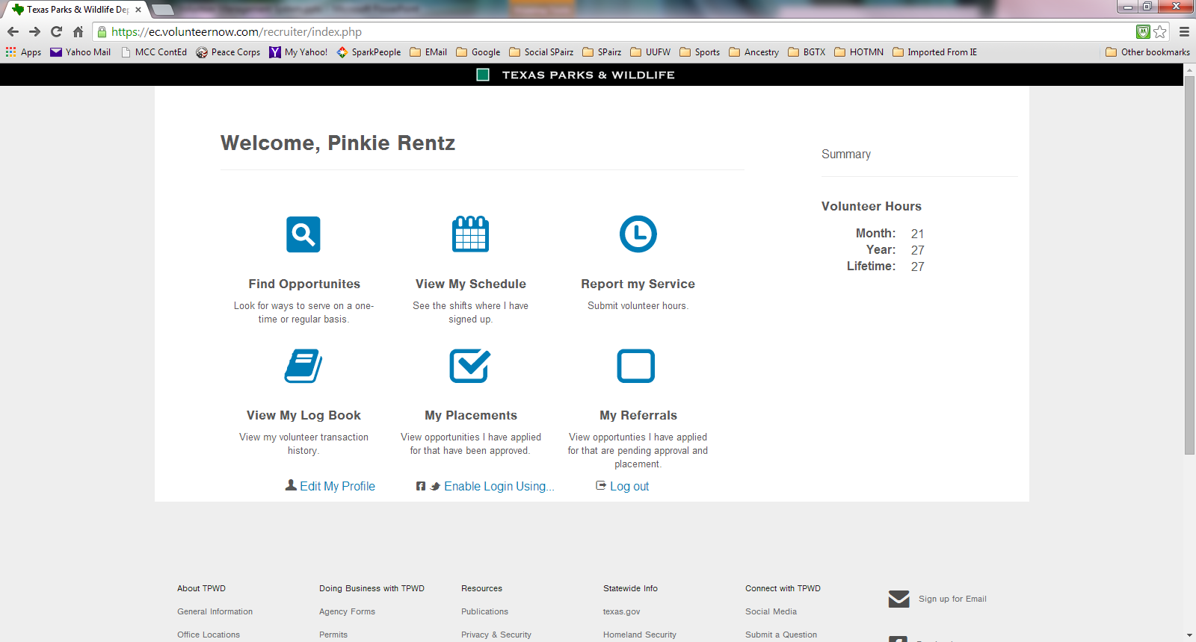
Volunteer Dashboard
Add your Hours Here
Online Search
View your reported Hours
You have 45 days to enter your hours
Change your password
Opportunities that you have been approved for

Slide 10
Edit My Profile
Change your volunteer password
Change your personal information in the system
Make sure your email address is up to date!
Get assistance on your password; if you forget it, you can have it emailed to your on-file email address

Slide 11
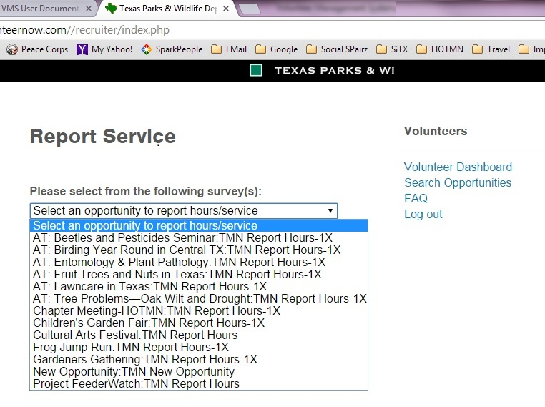
My Placements: Opportunities for which you are approved
TMN Report Hours-1X indicates that you can only enter data once.
TMN Report Hours indicates that you can add hours multiple times
TMN New Opportunity is what you fill out to give your admin new opportunity information.

Slide 12
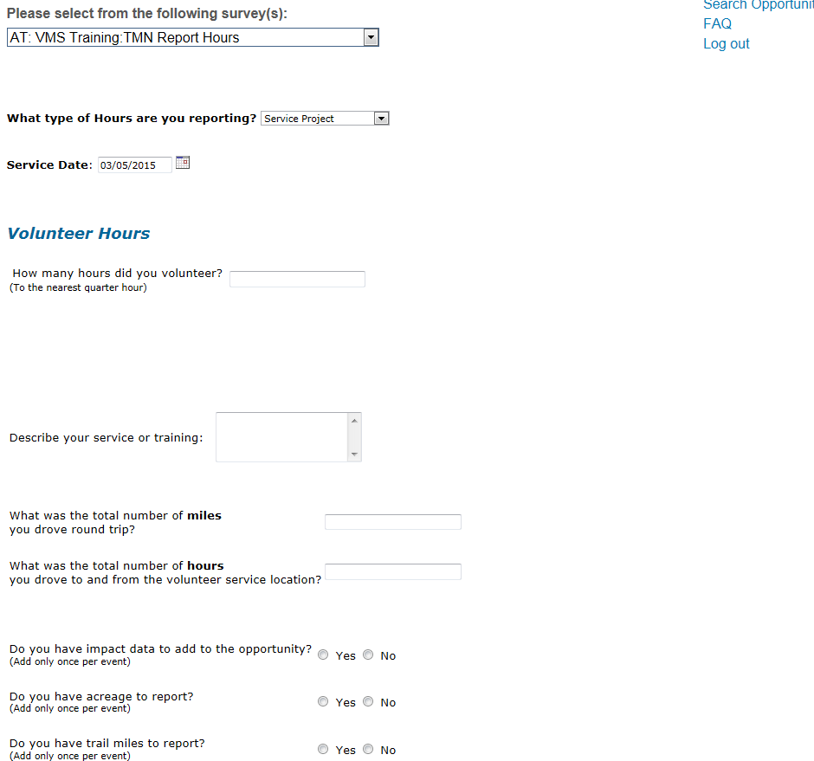
Report My Hours

Slide 13
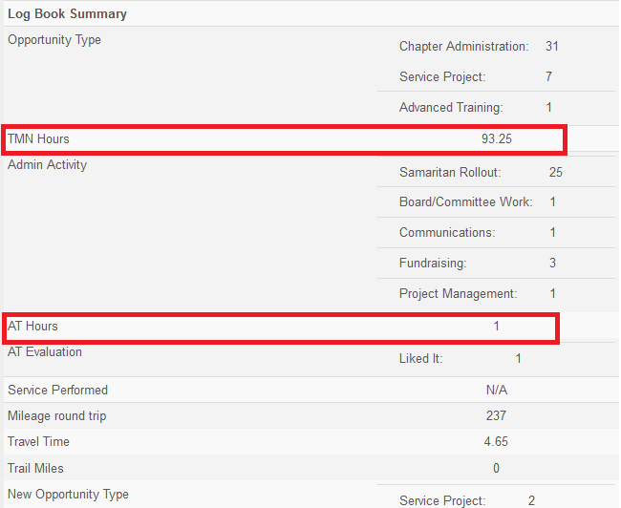
View My Log Book – My Hours

Slide 14
What Opportunity Do My Hours Go Under
Most important thing: REPORT YOUR HOURS!
Both service and AT hours will be posted under the opportunity that you attended; that includes planning, preparation, and follow-up by the project coordinator for most opportunities
If you are in doubt, contact your Chapter VMS administrators

Slide 15
Summary of “Common Opportunities”
AT: Chapter Meeting
Chapter Meeting non-AT
Administrative Work
Presentations
AT: VMS Training
Initial Training
New Opportunity
Historical Data
Notes:
Give examples of the opportunities for each type:

Slide 16
Chapter Common Opportunities
AT: Chapter Meeting
Has an advanced training component
Regularly scheduled meeting
Carries AT hours not service hours
No travel time is reported
Did you help set up the meeting area? That would go under “Chapter Meeting Non-AT” and travel could be counted based on chapter policy

Slide 17
Chapter Common Opportunities
Chapter Meeting Non-AT: Any chapter meeting activity that does not include an AT component; provides service hours
Chapter Business Meeting with a service component
Preparation for, setup and take down
Travel to and from service component meeting
Preparing refreshments, handouts

Slide 18
Chapter Common Opportunities
Administrative Work – service hours
Chapter Administration
Does the activity support chapter administration?
Officer duties (President, Treasurer, etc)
Manage Newsletter, Web Page, Hospitality, Facebook
Board/Committee work

Slide 19
Chapter Common Opportunities
Community Presentations (training others)
Presenter who is representing the TMN chapter at a community event or a chapter event (this includes preparation time)
Lead an interpretive walk/tour
Preparing for and/or leading an initial training topic or AT session for a group Master Naturalists or trainees
Although presenting chapter business reports could be here, Administrative Work would be a better fit

Slide 20
Chapter Common Opportunities
AT: VMS Training – Advanced Training
Any training activity by the learner relating to the learning of the VMS system
Administrator/Approver Training
Volunteer Training
Studying documentation on the VMS Help Desk

Slide 21
Chapter Common Opportunities
Initial Training – provides neither AT nor service hours
Comprises the initial Master Naturalist training using the state curriculum
New Trainees should record their class hours and topics using this opportunity although no service nor AT hours are awarded for the initial training
Record the date, topic, and number of hours; some days may have multiple entries

Slide 22
Things that can go wrong
You must enter your MN hours within 45 days
What if I miss the cutoff? Contact your chapter President
You may lump hours for multiple days together in one entry only for those opportunities with a Field Research category (CoCoRaHS for example)
Be sure to choose the correct opportunity; i.e. Angler Ed may have a TPWD opportunity and a TMN opportunity (same event, date, etc)
Your hours will count toward whichever one you post them to but cannot go towards both and is very difficult to undo and repost
Notes:
Miss the cutoff: enter the hours with a December 31, 2015 date and include in the description of what you did the actual date; the administrator will have to enter the correct date for you prior to approval. A common mistake made when you cannot see the hours you would expect to see is that the date range you have set is not correct.

Slide 23
More Things that Could Go Wrong
Choose the correct opportunity; All AT session names begin with “AT:”
You may change or delete a log book entry until the hours are approved by your hours keeper.
After that, the administrator must delete it or edit it to make corrections
Can’t see the opportunity you want to report for?
Contact your chapter VMS administrators and let them know
Can’t see your hours?
Ensure the date range is set correctly at the top of the log book display!

Slide 24
Summary
Current URLs can always be found at
T\txmn.org/apply
txmn.org/hours/
txmn.org/help
Remember your user ID and password
Report your hours! Each one is important.
Review your log book for accuracy
Edit your profile & change your password
There is a 45 lock out on reporting hours
You cannot lump days together

Slide 25
Where to get help
Questions about hours: your hours keeper
Questions about opportunities: your chapter VMS administrators
Questions about Initial Training: your new class coordinator/director
Other resources: the VMS Help Desk
Last resort: log a Help Desk ticket at txmn.org/help (no log in is required)

Slide 26
Questions? Don’t forget to log out.

