Slide 1
Samaritan Volunteer Management System for Texas Master Naturalists
March 2015

Slide 2
Why VMS
Selected by Texas Parks and Wildlife for managing volunteer hours
Federal auditors encouraged TPWD to implement a centralized hours reporting system
All TMN chapters will be converting to the VMS
Tier 1 consists of 8 chapters; all are in the conversion process
There are three members of the Implementation Team statewide

Slide 3
What is the VMS
VMS is an acronym for Volunteer Management System (the publisher is a company called Samaritan)
It is web based software consisting of an administrator (eCoordinator) component and a volunteer (eRecruiter)component
There are no known restrictions on the browser used with the volunteer component; administrators must use Internet Explorer

Slide 4
Definitions
Opportunities: Service Projects or AT events.
Common Opportunities: those opportunities used by nearly all chapters; created for you
Survey: Form the volunteers use to enter hours
Log book: the record of volunteer TMN hours
TMN Hours: service hours applied to a TMN event
AT Hours: advanced training hours (TMN)
Hours: hours earned at any other TPWD event
VMS Web Portal: txmn.org/tmn-vms-users/

Slide 5
Opportunity
Equivalent of a project
The opportunity must be setup in the system before anyone can enter hours (title, description); Even if the event is “pre-approved”
Opportunities can be a specific date or span a date range (most will have a date range)
The Approver attaches a ‘Survey’ to each opportunity; The Approver approves volunteers to the opportunity
The survey is used by volunteers to create a Log Book entry of their MN hours.

Slide 6
‘Opportunities’ = Projects
Volunteer Service Project (without a Specific Date): Nature Fest 2015, Mother Neff State Park Workday
Volunteer Service Project (with a Specific Date & Time): Mother Neff State Park Grand Reopening
Advanced Training: “AT: Whooper Watch”, “AT: VMS Training”
Common Opportunities: generally opportunities used by every chapter
New Opportunity Submission
(to request that an opportunity be added or published)

Slide 7
Summary of “Common Opportunities”
AT: Chapter Meeting – has an AT component
Chapter Meeting non-AT – no AT component
Administrative Work – officer duties
Presentations – used by MN presenters
AT: VMS Training – any learning of the VMS
Initial Training – prospective MN’s in training
New Opportunity-not all chapters will use this
Historical Data (AT or Service Hours)

Slide 8
The Process - Generally
Approver: An Opportunity is created and a Survey is attached
Approver: It may – or may not be – published to the Internet
Approver: Members are ‘approved’ for the opportunity
Volunteer: Members report their service online
Hours Keeper: The Administrator approves their hours

Slide 9
Register as a TPWD Volunteer
All Master Naturalists need to be registered with TPWD as a volunteer and issued a VMS user ID
Registration web site: tpwd.texas.gov/volunteer
Scroll to the bottom and click on “Texas Master Naturalist”
Search for “Apply to “; select your Chapter name
You must agree to a background check and agree to a Workforce Waiver to be registered
All current members of converted chapters are pre-registered already, but the member must complete the registration process themselves

Slide 10
Your Volunteer User ID
When you were pre-registered, you were issued a user ID (some selected their own user ID)
The password is case sensitive
If the user ID was created for you (TMN-…) you should change your password when you first log in
Passwords must be at least 8 characters long and include at least one numeral
You may change your password by “editing your profile” on the volunteer dashboard

Slide 11
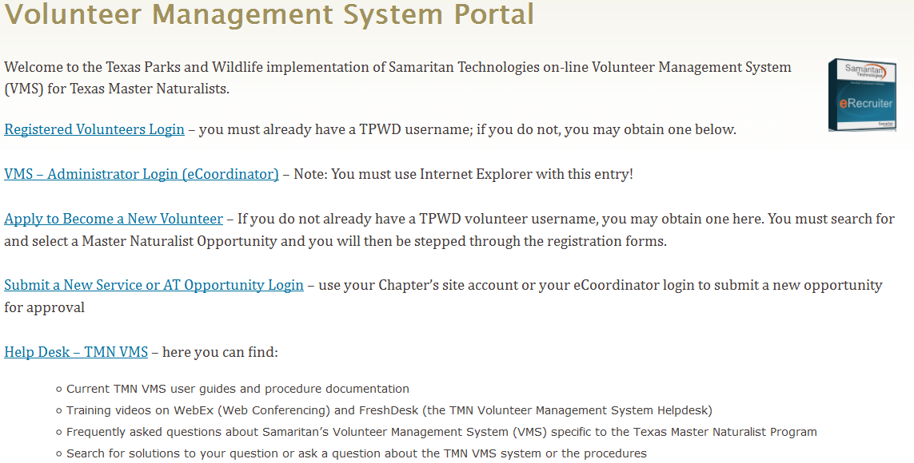
VMS Web Portal 1-stop shop for URLS txmn.org/tmn-vms-users/

Slide 12
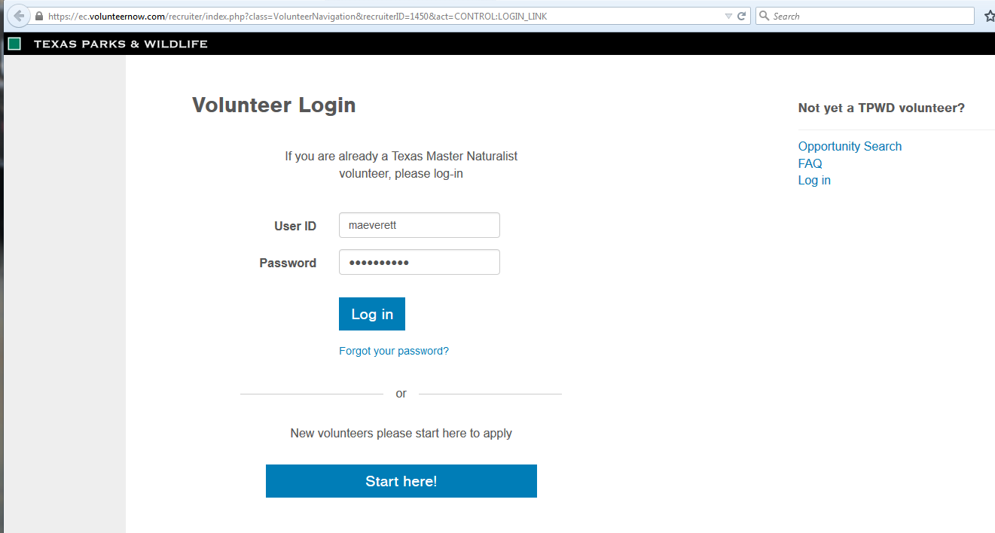
Volunteer Login Page

Slide 13
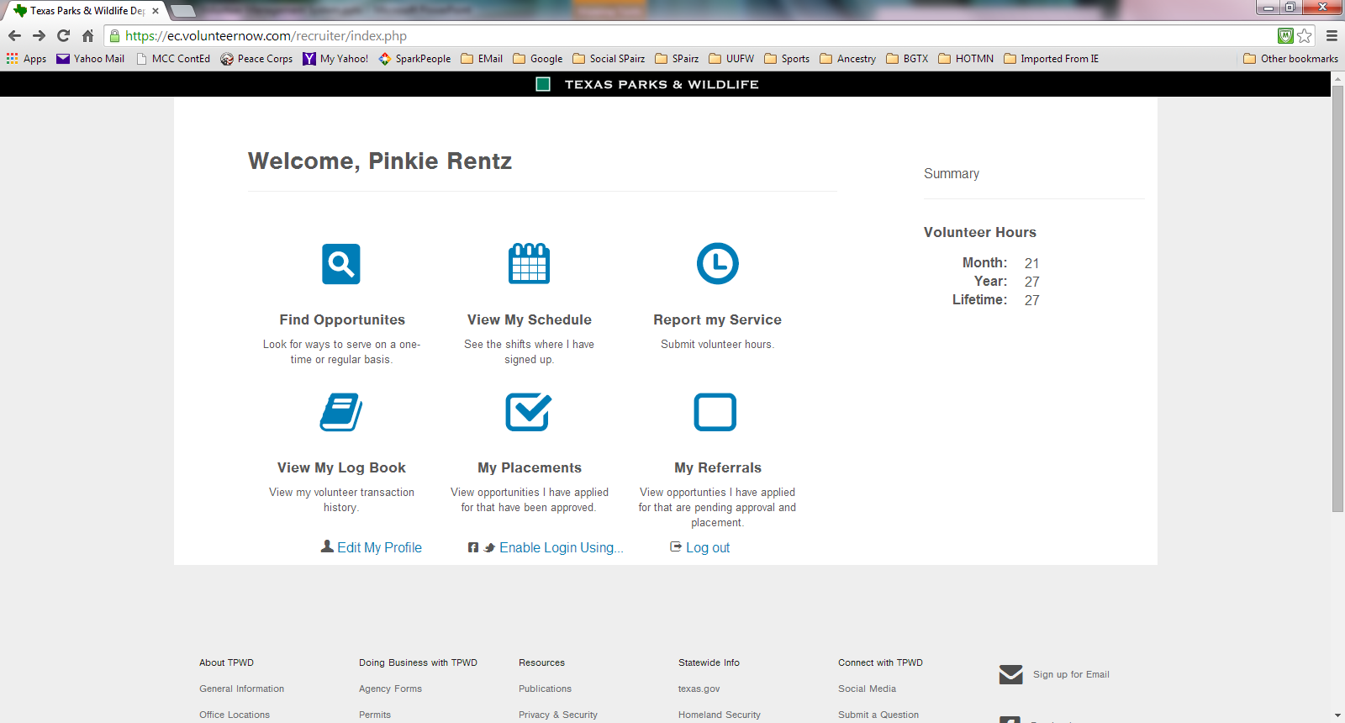
Volunteer Dashboard
You have 45 days to enter your hours
Add your Hours Here
Online Search
View your reported Hours
Change your password
Opportunities that you have been approved for

Slide 14
Edit My Profile
Change your volunteer password
Change your personal information in the system
Make sure your email address is up to date!
Get assistance on your password; if you forget it, you can have it emailed to your on file email address

Slide 15
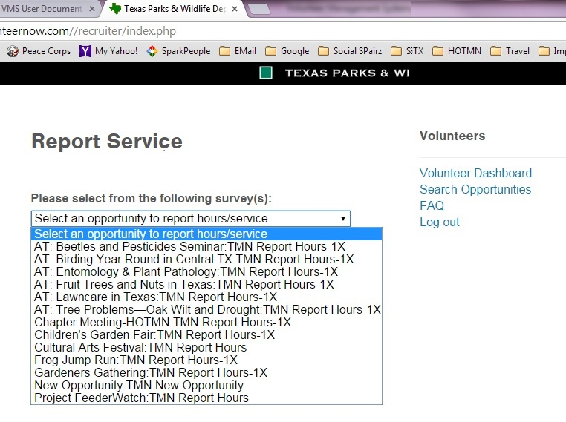
My Placements: Opportunities that you are approved for
TMN Report Hours-1X indicates that you can only enter data once.
TMN Report Hours indicates that you can add hours multiple times
TMN New Opportunity is what you fill out to give your admin new opportunity information.

Slide 16
Surveys: a form
TMN Report Hours: Multiple use survey used for activities or events where there is prep or finish work done by your members or they recur or they occur over multiple days.
TMN Report Hours-1X : Single use survey used when members will only enter hours once for this opportunity.
Surveys have impact data on them – if you have it to fill out (project managers).
“TMN New Opportunity” : Used by members who have a new event or activity that is not in the system. Some chapters will choose not to use this, but instead continue to use their own process.
TMN Field Research: Survey used for Field Research category opportunities (allows for a date range)

Slide 17
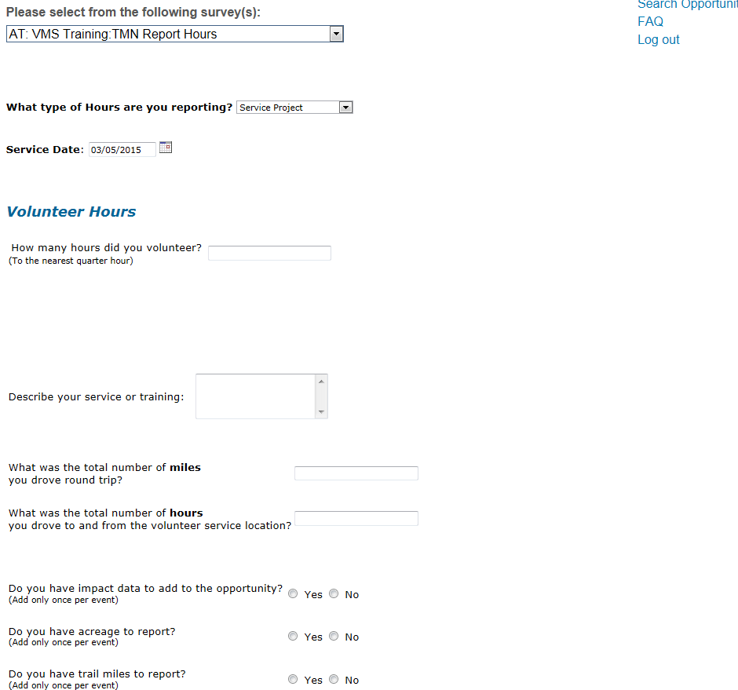
Report My Hours (this is a survey)

Slide 18
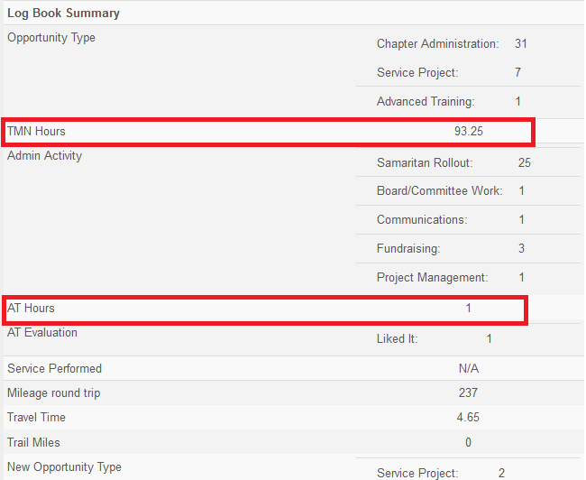
View My Log Book – My Hours

Slide 19
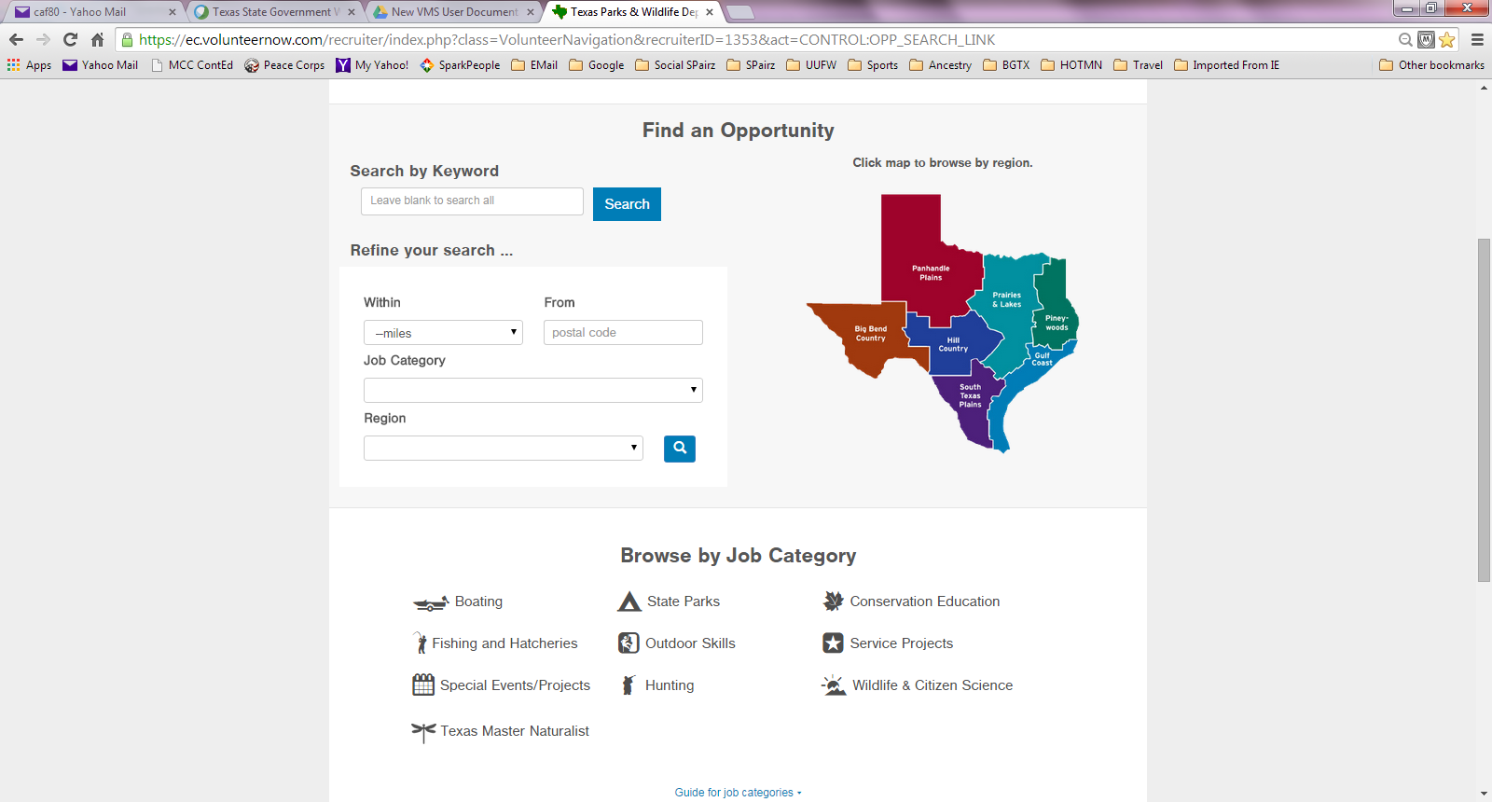
Searching for Opportunities
‘AT:’ to find AT Opportunities
Type the month (‘Nov’ or ‘November’, not ‘11/’) to find opportunities by month

Slide 20
What Opportunity Do My Hours Go Under
Most important thing: REPORT YOUR HOURS!
Don’t get hung up if you can’t figure out where they go; do the best you can
In general, both service hours and AT will be posted under the opportunity that you attended; that includes planning, preparation, and followup by the project coordinator for most opportunities
Occasionally there are things you do that do not necessarily fall under a specific named opportunity
That’s where the Common Opportunities come in

Slide 21
Summary of “Common Opportunities”
AT: Chapter Meeting
Chapter Meeting non-AT
Administrative Work
Presentations
AT: VMS Training
Initial Training
New Opportunity
Historical Data
Notes:
Give examples of the opportunities for each type:

Slide 22
Chapter Common Opportunities
AT: Chapter Meeting
Has an advanced training component
Regularly scheduled meeting
Carries AT hours not service hours
No travel time is reported
Did you help set up the meeting area? That would go under “Chapter Meeting Non-AT” and travel could be counted based on chapter policy

Slide 23
Chapter Common Opportunities
Chapter Meeting Non-AT: Any chapter meeting activity that does not include an AT component; provides service hours
For example:
Chapter Business Meeting with a service component
Preparation for, setup and take down
Travel to and from service component meeting
Preparing refreshments, handouts

Slide 24
Chapter Common Opportunities
Administrative Work – service hours
Chapter Administration
Does the activity support chapter administration?
Officer duties (President, Treasurer, etc)
Manage Newsletter, Web Page, Hospitality, Facebook
Board/Committee work
Samaritan Rollout presentation/data gathering/entry
If it is more in support of a specific project , then the hours go under that project
Service Project
Write an article for the newsletter (example)
Fundraising efforts

Slide 25
Chapter Common Opportunities
Community Presentations (training others)
Provides service hours
Presenter who is representing the MN chapter at a community event or a chapter event (includes preparation time)
Lead an interpretive walk/tour
Preparing for and/or leading an initial training topic or AT session for a group of MNs or trainees
Although presenting chapter business reports could be here, Administrative Work is a better fit

Slide 26
Chapter Common Opportunities
AT: VMS Training – Advanced Training
The one exception to the self-study exclusion for AT (self-study can apply to learning the VMS)
Any activity relating to the learning of the VMS system
Administrator/Approver Training
Volunteer Training
Studying the documentation on the VMS HelpDesk
Exception: Data gathering/entry, for those whose responsibility it is, should be reported as Chapter Admin under “Administrative Work”: VMS Rollout

Slide 27
Chapter Common Opportunities
Historical Data – hours earned by members prior to the current calendar year
Has an AT component (Historical Data AT Hours)
Has a service component (Historical Data Service Hours)
Appear as a volunteer’s yearly total for AT and a yearly total for service hours for each year prior to the current calendar year since becoming a MN

Slide 28
Chapter Common Opportunities
Initial Training – provides neither AT nor service hours
Comprises the initial Master Naturalist training using the state curriculum
New MN Trainees can record their class hours and topics using this opportunity although no service nor AT hours are awarded for the initial training
Record the date, topic, and number of hours; some days may have multiple entries

Slide 29
Chapter Common Opportunities
New Opportunity – neither service nor AT
Used to submit a proposed chapter opportunity (AT or service); the chapter’s current method of submitting new proposed opportunities can also be used
Can be an opportunity that has already been attended though there is no guarantee of approval
Can be an opportunity with a future date (preferred method)
Is reviewed and, if approved, is entered to the VMS by the opportunity approval committee

Slide 30
Things that can go wrong
You must enter your MN hours within 45 days
What if I miss the cutoff? Contact your VMS admin
We are already outside 45 days for most of January…
You may lump hours for multiple days together in one entry only for those opportunities with a Field Research category (CoCoRaHS for example)
Be sure to choose the correct opportunity; i.e. Angler Ed has a TPWD opportunity and a TMN opportunity (same event, date, etc)
Your hours will count toward whichever one you post them to but cannot go towards both
Notes:
Miss the cutoff: enter the hours with a December 31, 2015 date and include in the description of what you did the actual date; the administrator will have to enter the correct date for you prior to approval. A common mistake made when you cannot see the hours you would expect to see is that the date range you have set is not correct.

Slide 31
More Things that Could Go Wrong
Choose the correct type (AT or service hours); All AT session names begin with “AT:”
You may change or delete a log book entry until the hours are approved by your hours keeper.
After that, the administrator must delete it or edit it to make corrections
Can’t see the opportunity you want to report for?
Contact your opportunity approver and let them know
Can’t see your hours?
Ensure the date range is set at the top of the log book!

Slide 32
When do we begin using the VMS?
The system is ready, as we meet, for you to begin recording your hours; begin with the month beginning 45 days back
What about hours before the 45 days?
You should have already submitted a time sheet to your hours keeper for those hours, because of the 45 day lock, the administrators will enter those hours using your timesheet
Your historical hours may or may not be posted yet; until they are, your career hours will not reflect the correct value
Notes:
Begin entering your hours now for February and March – you do not have to wait until the end of the month to enter hours. January hours will be posted by the administrator from your January time sheet. Your historical hours from prior years have already been entered as an annual total for each year

Slide 33
Do we continue keeping a timesheet?
Although it is up to your chapter admin, it is recommended that you keep a paper copy of your hours and that you use it to enter your hours online
Serves as a backup if there any questions
Helps to avoid duplicate entries
Once you begin using the online system:
Check with your chapter to see if you should continue to submit hours to the former system
You may monitor your progress toward recertification and milestones using your log book (set the appropriate date range – once the historical hours are posted)
Notes:
Highly recommended.

Slide 34
Summary
Current URLs can always be found at
txmn.org/tmn-vms-users/
Log in using your volunteer user ID
Report your hours! Each one is important.
Review your log book for accuracy
See what you are approved for
Edit your profile & change your password
There is a 45 lock out on reporting hours
You cannot presently lump days together

Slide 35
Where to get help
Questions about hours: your hours keeper
Questions about opportunities: your chapter opportunity approvers
Other resources: the VMS Help Desk
Last resort: email the team at tmnvms@gmail.com

Slide 36
Questions? Don’t forget to log out.

